Slide 7
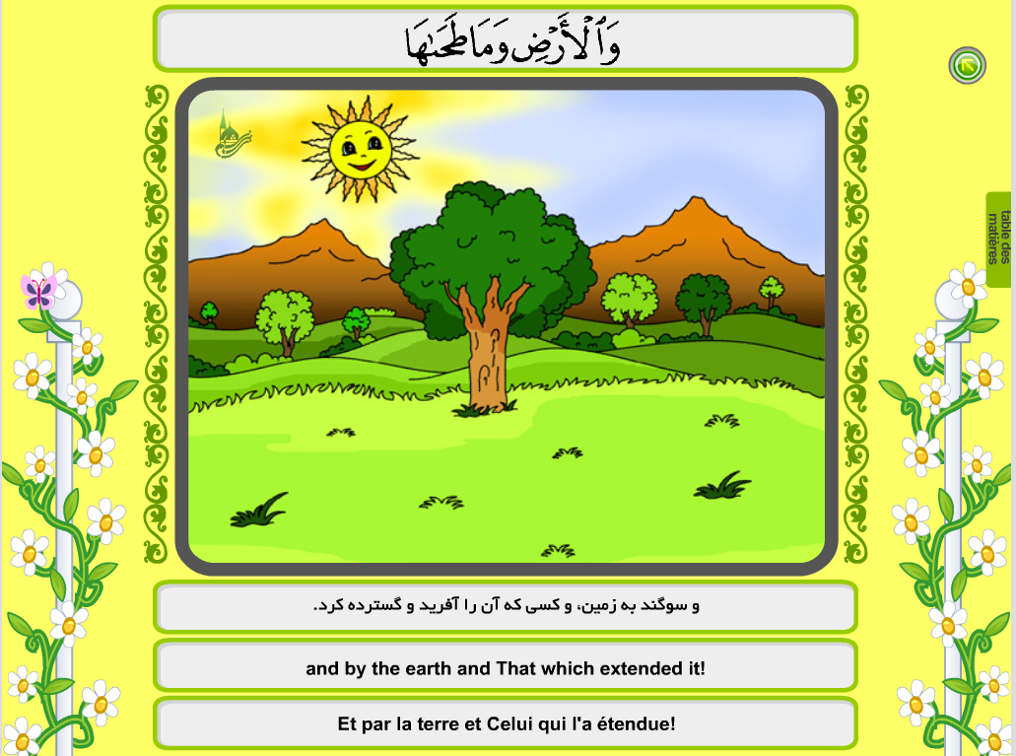

Slide 8
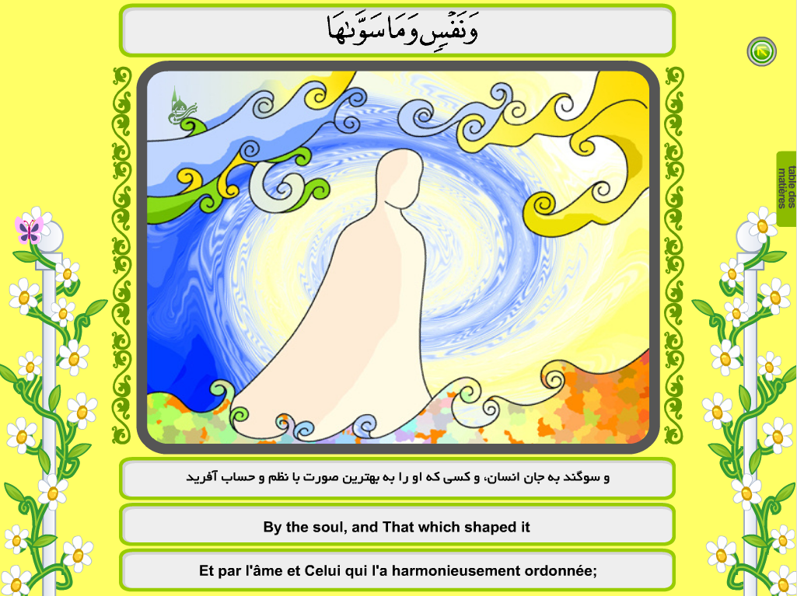

Slide 17
SOURCE : Bani Hashem Publications

